Slide 1
R I S K M A N A G E M E N T

Slide 2
INTRODUCTION
Every project is susceptible to risks
Without effective risk management, even the planned projects become failure
Project manager should anticipate & identify different risks susceptible to the project
He should prepare contingency plans before hand to contain the risk
Risk management
It aims to reduce the chances of risk becoming real
Also reduces the impact of a risk that becomes real

Slide 3
Risk Category 1
Project Risk
Product Risk
Process Risk
Business Risk

Slide 4
Project Risk:
Risk which affect the project Schedule or Resources
Product Risks
Risk which affect the quality or performance of the software being developed.
Process Risk
Risk related to managerial And technical procedures followed to build the product.
Business Risk
Risks which affect the organisation developing or procuring the software.

Slide 5
Risk Category 2
Known Risk
Predictable Risks
Unpredictable Risks.

Slide 6
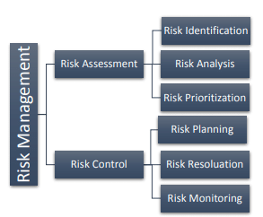
Barry Boehm Steps in Risk Management

Slide 7
ACTIVITIES OF RISK MANAGEMENT
3 activities
Risk Identification
Risk Assessment
Risk Mitigation

Slide 8
RISK IDENTIFICATION
Project manager needs to anticipate the risks in the project as early as possible
After identifying the risks, risk management plans are made
Risk identification is similar to listing down the nightmares by the manager
Eg: vendors not completing their work on time
Poor quality work
Manpower turnover

Slide 9
RISK IDENTIFICATION [2]
To identify the risks systematically, we have to categorize risks into different classes
Project manager examines the risks in each classes
Identify the risks that are relevant to the project
Categories of risks are
Project risks
Technical risks
Business risks

Slide 10
RISK IDENTIFICATION [3]
Project risks
This include problems related to
Budgetary
Schedule
Personnel
Resource
Customer related issues
Important project risk is schedule slippage
This arises since the software projects are difficult to monitor
Due to its invisibility it is very difficult to asses the progress

Slide 11
RISK IDENTIFICATION [4]
Technical risks
It includes problems related to
Potential design
Implementation
Interfacing
Testing
Maintenance
Technical risks also includes
Incomplete specification
Changing specification
Technical uncertainty
Most of the technical risks arises due to insufficient knowledge about the product

Slide 12
RISK IDENTIFICATION [5]
Business risks
This includes
Risk of building a product that no one wants
Losing budgetary commitments
To successfully identify risks, it is good to have a company disaster list
Company disaster list
Contains all the bad events that have happened to the s/w projects of the company over the years
This list can be read by the project manager to be aware of susceptible risks to the project

Slide 13
R I S K A S S E S S M E N T
Objective of risk assessment is to rank the risks in terms of their damage causing potential
Each risk is rated in 2 ways
The probability of risk becoming real (r)
The consequence of problems associated with that risk(s)
Based on these two factors priority of each risk is calculated
P=r*s
P➔ priority with which the risk should be handled
r➔ probability of the risk becoming real
s➔ severity of damage caused if the risk becomes real
If all the risks are prioritized, then the most likely and damaging risks are handled first

Slide 14
R I S K M I T I G A T I O N
After identifying all risks, plans are made to control the most damaging and likely risks first
Different risks have different containment/control procedures
Strategies for risk containment
Avoid the risk
Transfer the risk
Risk reduction

Slide 15
R I S K M I T I G A T I O N
Avoid the risk
Risks can be avoided in several ways
Risks often arises due to project constraints
So risks can be avoided by modifying the constraints
Categories of constraints which give rise to risks
Process related constraints
Product related constraints
Technology related constraints

Slide 16
R I S K M I T I G A T I O N
Process related constraints
Risks arises due to following constraints
Aggressive work schedule
Budget
Resource utilization
Product related constraints
Risks arises due to
Commitment to challenging product features
Quality
Reliability
Technology related constraints
Risks arises due to
Use of certain technology

Slide 17
R I S K M I T I G A T I O N
Risks can be avoided by
Discussing with customer to change the requirements
Giving incentives to the developers to avoid the risk of manpower turnover

Slide 18
R I S K M I T I G A T I O N
Transfer the risks
This involves getting the risky components developed by a third party
Or buying insurance cover etc
Risk reduction
This involves planning different things to contain the damage due to a risk
Eg: if there is a risk of manpower turnover, new recruitment can be planned
Technical risks can be reduced by building a prototype of the technology that you are going to use

Slide 19
R I S K M O N I T O R I N G & M A N A G E M E N T

Slide 20
RISK MONITORING
As the project proceeds, risk-monitoring activities commence.
The project manager monitors factors that may provide an indication of the risk
Risk monitoring is a project tracking activity
Objectives
Assess whether predicted risks occur or not
Ensure that risk aversion steps defined for the risk are being properly applied
Collect information that can be used for future risk analysis.

Slide 21
EXAMPLE: HIGH STAFF TURNOVER
The factors monitored for the above risk
The general attitude of team members based on project pressures
Interpersonal relationships among team members
Potential problems with compensation and benefits
Availability of jobs within the company and outside it are all monitored

Slide 22
Other factors monitored
Project manager should monitor the effectiveness of risk mitigation steps.
Suppose that the risk mitigation step taken to resolve manpower turnover is proper documentation
Manager has to monitor the following
Check whether work products or documents are developed in a timely manner.
This is to ensure continuity
Newcomer gets necessary information from these documents, if he is forced to join the software team in the middle of the project

Slide 23
RISK MANAGEMENT
Risk management is done if the risk mitigation efforts are failed & risk has become a reality
In such a case, if we have followed mitigation strategy, then
Backup will be available
Information will be documented
knowledge has been dispersed across the team.
Newcomers must be added to the team to “get up to speed.”
Those individuals who are leaving are asked to stop all work and spend their last weeks in “knowledge transfer mode.”
This might include
video-based knowledge capture,
the development of commentary documents
meeting with other team members who will remain on the project.

Slide 24
RMMM plan
A risk management strategy can be included in the software project plan,
The risk management steps can be organized into
Risk Mitigation Monitoring Management plan.
The RMMM plan documents all work performed as part of risk analysis
It is used by the project manager as part of the overall project plan.

Slide 25
RISK INFORMATION SHEET
Some software teams do not develop a formal RMMM document.
Each risk is documented individually using a Risk Information Sheet (RIS)
RIS is maintained using a database system
Creation and information entry
Priority ordering
Searches
Other analysis may be accomplished easily

Slide 26
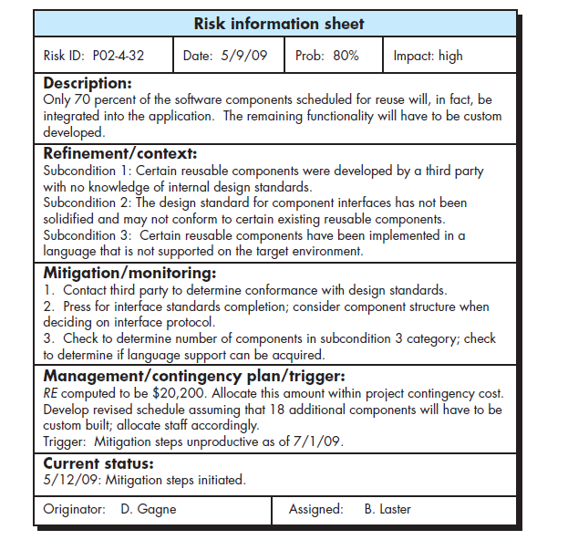
RISK INFORMATION SHEET

Slide 27
Thank You…..

